Slide 1
Call for Evidence: UCITS EAD - Supporting data
July 2024

Slide 2
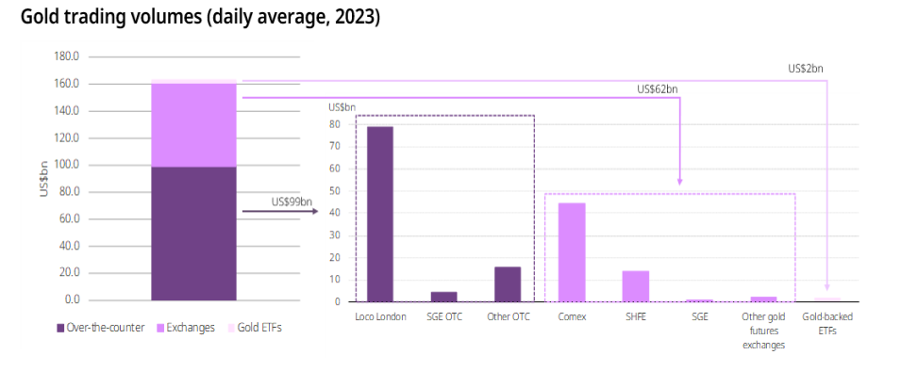
Market size

Slide 3
Liquidity: Average daily trading volumes over the last year in US dollars
Source: Bloomberg, Bank for International Settlements, FINRA TRACE, International Capital Market Association (ISMA), Nasdaq, World Gold Council; Disclaimer
*Based on estimated one-year average trading volumes from 01 January 2023 to 31 Dec 2023, except for currencies that correspond to April 2022 daily volumes due to data availability.
**Gold liquidity includes estimates on over-the-counter (OTC) transactions and published statistics on futures exchanges, and gold-backed exchange-traded products. For methodology details visit the liquidity section at Goldhub.com.

Slide 4
Volatility: Average daily volatility of several major asset classes over the last 20 years
Sources: Bloomberg, World Gold Council. *Annualised volatility is computed based on daily returns in EUR between 31 December 2003 and 31 December 2023. Computations for ‘Bloomberg Euro Aggregate bonds’; ‘European equities’: FTSE Europe Index; ‘Global equities’: FTSE Developed World Total Return Index EUR; ‘EM equities’: MSCI Daily Gross EM; ‘gold’: LBMA Gold Price PM, ‘Crude oil’: Bloomberg WTI Crude Oil; ‘REITs’: FTSE Nareit Equity REITs Index; ‘private equity’: S&P Listed Private Equity Index.

Slide 5
Returns: Key global assets in EUR
Source: Bloomberg, ICE Benchmark Administration, World Gold Council
*As of 31 December 2023. Computations in EUR of unhedged total return indices unless otherwise specified. For euro Cash: Barclays 3m Euribor Cash Index ; Euro treasuries: Bloomberg Euro treasury Index ; European, Global and EM stocks: MSCI Europe Index, MSCI World ex Europe index and MSCI EM index respectively; Commodities: Bloomberg Commodity Total Return Index; and Gold: LBMA Gold Price PM (spot). Compounded annual growth rate (CAGR) computed as the geometric average from the start to the end of the period.

Slide 6
Gold historically performs well in periods of high inflation
Gold has kept up with money supply growth
*Based on y-o-y changes for the LBMA Gold Price PM in euro and euro CPI between December 1975 and December 2023 in EUR.
** For each year on the sample, real return = (1+nominal return)/(1+inflation)-1.
Source: Bloomberg, ICE Benchmark Administration, World Gold Council
*As of 31 December 2023. Based on US M2 cumulative growth, US CPI and LBMA Gold Price PM USD. Gold (US$/oz), US M2, US CPI indexed: 1971 = 100
Source: Bloomberg, ICE Benchmark Administration, World Gold Council

Slide 7
Diversification
Correlation between gold, German Bunds and global stocks in various environments of stocks’ performance (since 1994)*
Source: Bloomberg, World Gold Council;
*Based on weekly returns of the FTSE Developed Total Return Index, Ice BofA German Government Index and LBMA Gold Price using data between 31 December 1993 and 31 December 2022. The middle bar corresponds to the correlation conditional on the FTSE Developed TR index weekly returns falling or rising between two standard deviations (or ‘σ’) over the full period. The bottom bar corresponds to the correlation conditional on the FTSE Developed TR index weekly returns falling by more than two standard deviations (or ‘σ’), while the top bar corresponds to the correlation conditional on the FTSE Developed weekly returns increasing by more than two standard deviations. The standard deviation is based on the same weekly returns over the full period. All calculations in euro.

Slide 8
Portfolio impact: risk-adjusted returns
Hypothetical diversified portfolio: asset allocation
Risk-adjusted returns of a hypothetical EUR portfolio with and without gold
The hypothetical average portfolio: 50% allocation to equities (40% MSCI World Net Total Return Index, 5% MSCI EM Net Total Return Index, 5% MSCI World Small Cap Net Total Return Index), 40% allocation to fixed income (20% Bloomberg Euro Treasury Index, 15% Bloomberg Euro Corporate Bond Index, 5% Bloomberg Global Corporate High Yield Total Return Index) and 10% allocation to alternative assets (3.3% FTSE REITs Index, 3.3% HFRI Hedge Fund Index and 3.3% Bloomberg Commodity Index).
Source: World Gold Council
*Based on EUR performance between 31 December 2003 and 31 December 2023. The hypothetical average portfolio: 50% allocation to equities (40% MSCI World Net Total Return Index, 5% MSCI EM Net Total Return Index, 5% MSCI World Small Cap Net Total Return Index), 40% allocation to fixed income (20% Bloomberg Euro Treasury Index, 15% Bloomberg Euro Corporate Bond Index, 5% Bloomberg Global Corporate High Yield Total Return Index) and 10% allocation to alternative assets (3.3% FTSE REITs Index, 3.3% HFRI Hedge Fund Index and 3.3% Bloomberg Commodity Index). The allocation to gold comes from proportionally reducing all assets. Risk-adjusted returns are calculated as the annualised return/annualised volatility. See important disclaimers and disclosures at the end of this report.
Source: Bloomberg, ICE Benchmark Administration, World Gold Council

Slide 9
Portfolio impact: optimisation and efficient frontier
Adding gold could significantly improve risk-adjusted portfolio returns
*Based on monthly EUR total returns from 31 December 2003 to 31 December 2023. ‘Equivalent return portfolio’ represents a portfolio with gold that could deliver the same return with a lower level of risk. ‘Equivalent volatility portfolio’ represents a portfolio with gold that could deliver higher returns for the same level of risk. Analysis based on mean variance optimisation. See important disclaimers and disclosures at the end of this report.
Source: Bloomberg, World Gold Council

Slide 10
Important information and disclosures

