Slide 1

Response to the ESMA
Call for Evidence on shortening the settlement cycle
Annexes
DECEMber 2023

Slide 2
Content
  Impact of the reduction of the securities settlement
  cycle in the operations of market players (Q1-Q4)
  Costs and benefits of a shorter securities
  settlement cycle (Q5-Q14)
  How and when to move to a shorter securities
  settlement cycle (Q15-Q20)
  International developments on settlement cycles
  and their impact on the Union's capital markets (Q21-Q27)

Slide 3
Executive summary
1. The financial industry already experienced a shortening of the settlement cycle in 2014 when moving from T+3 to T+2, hence there is knowledge on how to deal with this type of initiative.
2. As regards the move to T+1 that the industry has now to face, the environment is more difficult. Indeed, some new constraints have to be considered:
  fragmented market infrastructure in the EU (14 currencies, 17 CCPs, 31 CSDs)
  specific regulatory requirements as regards
    risk management
    value for money with justification of costs charged to investors
3. The rationale of the move to T+1 is mainly based on capital requirements reduction benefiting to the credit institutions selling financial product.
4. The move to T+1 has unfortunately no direct benefit for asset managers, who are net buyers of financial instruments.
5. The move to T+1 creates a liquidity mismatch between the settlement date of the fund (typically T+3) and the date of investment in US underlying (T+1). This mismatch generates a cost of trading rise (new cut-offs) as well as a cost of funding rise. The funds’ custodians will be in a position to propose more services to cover this mismatch.
6. Against this background, the longer the transition period between the US T+1 and the EU T+1 go-live (ca. 4 years), the more detrimental it will be for asset managers.
7. It is likely that certain asset managers will be able to isolate the specific T+1 cost and will pass them on to the end investors.
© ALFI 2023
INTERNAL

Slide 4
I. Q1-1
US T+1 workflow at DTC ¹
T+0
T+1
Trading
Trading
Night settlement cycle
Allocation
Confirmation
Affirmation ²
Delivery orders
US (EST)
4pm
7pm
9pm
11:30pm
1:30am
3:20pm
EU (CET)
10pm
1am
3am
5:30am
7:30am
9:20pm
Allocation
Start of night cycle
End of night cycle
End of night cycle
US market closure
Affirmation Cut-off
¹ Source: Accelerated Settlement (T+1), DTCC, June 2023.
² The Allocation process occurs when an Investment Manager sends instructions to its Broker on how to allocate a block trade to underlying client funds. Once the Allocation has been completed, the Confirmation and Affirmation process occurs, providing a detailed record of a transaction. Source: Automated Institutional Trade Processing Required to Achieve T+1, DTCC, 21 March 2022.
© ALFI 2023
INTERNAL

Slide 5
I. Q1-2
Liquidity mismatch in the subscription/redemption processes Investment/Divestment vs. Investor settlement
Illustration of the subscriptions and redemptions operations into a mutual funds with an underlying composed of US securities, considering the typical T+3 settlement cycle of the mutual funds & platform/distributor.
Day 0
Day 1
Day 2
Day 3
I. Net Inflows
T+0
T+1
T+2
T+3
Investors
Investor Subscriptions
Subscription payments
Portfolio
Purchase US securities
Settlement
II. Net Outflows
T+0
T+1
T+2
T+3
Investors
Investor Redemptions
Redemption proceeds
Portfolio
Sell
US securities
Settlement
+1 BD Mismatch
Cash management
© ALFI 2023
INTERNAL

Slide 6
I. Q1-3
Recommendations to EU policy makers
Methodology
Consider the distinction between
  secondary market transactions and
  primary market transactions
which allows to better consider the situation of the asset management industry essentially involved in primary markets.
Indeed,
  while the move of secondary market transactions to T+1 will be mainly solved through market infrastructures adjustments outside the asset manager’s sphere,
  primary market transactions will imply organisational changes in the business model of asset managers and their relationships with their business partners.
2. t+2 as legal reference for the transition period
During the transition period (ie. US T+1/EU T+2) keep T+2 as the legal reference, in line with CSDR, while certain segments of the markets will move to T+1 on a voluntary basis, for competitiveness reasons.
3. Measures to be taken
Provide guidance on how to handle point-in-time breaches of cash limits (pursuant to Art. 52(1) UCITS Directive) due to settlement cycle misalignment, as a specific impact of the unwanted T+1 move. Grant a temporary carve out for these technical breaches.
Provide guidance on how to handle point-in-time breaches of borrowing limits, and on how to interprete the temporary basis notion that makes a borrowing eligible (pursuant to Art. 83(2) UCITS Directive) due to settlement cycle misalignment, as a specific impact of the unwanted T+1 move. Grant a temporary carve out for these technical breaches.

Slide 7
I. Q1-4
Timeline for the temporary exemption of cash/borrowing breaches
Illustrative proposal subject to calibration
2023
2024
2025
2026
2027
2028
2029
ESMA CfE
15 Dec.
US T+1 Go-live
28 May
End of exemption
28 May
EU T+1 Go-live
28 May
End of the extension
European
Commission
1
4
Temporary exemption (24 months)
Possible extension
ESMA
/ NCA
A
Consultation
on impacts
and remedies
Asset Management industry
2
3
Data collection
Back testing
B
Adjustment of investment funds settlement process
Rest of the ecosystem
C
Adjustment of the ecosystem, including custodial and distribution (banks, platforms) processes
© ALFI 2023

Slide 8
I. Q1-5
Recommendations to EU policy makers
A
Consultation
Description of the remedies proposed by the industry to address the identified impacts
If operational remedies do not suffice, support will be asked to the policy makers
Adjustment
of Investent Funds processes
Bring forward the settlement date of the fund, where relevant, typically from T+3 to T+2 or even T+1
Update processes with custodians to ensure T+1 settlement
Update processes with funds distributors (banks, platforms) to provide the cash from investors earlier than T+3
B
C
Adjustment
of the ecosystem
Custodians will update their offer and processes
Funds distributors (banks/platforms) will update their offer and processes
Other service providers to investment funds will update their offer and processes
1
Temporary
exemption
a. In order to mitigate the impact of T+1, policy makers would grant a temporary exemption as regards breaches of the UCITSD cash/borrowing limits, specifically due to the T+1 impact.
b. The corresponding legal instrument could be for instance:
i. delegated act from the European Commission in relation to the corresponding articles of the UCITSD.
ii. forbearance from ESMA asking the NCAs not to “prioritise their supervisory actions” as regards the potential
breaches of UCITSD limits due to T+1. This forbearance could be drafted in the same way as the one of 2019 for
EMIR SFCs ¹.
2
Data collection
Crossing of the UCITSD limits need to be documented and justified (ie. crossing vs. investment in US market) by the asset manager. The purpose is to isolate the T+1 impact, in order to be able to restrict the forbearance to T+1 events.
3
Back testing
Based on the data collected, a trend will be assessed to observe the magnitude of the breaches (amount and frequency).
We assume these breaches will be only point-in-time, and related to the fund’s exposure in US securities, and the size of transactions.
4
Possible extension
The back testing will allow to determine a possible extension until the EU officially moves to T+1, with all the EU ecosystem adjusted.
¹ ESMA70-151-2050, 31 January 2019.

Slide 9
I. Q1-6
Recommendations to EU policy makers
UICTSD provisions
Our interpretation of the applicability in the T+1 context
Book-entry form
Art. 57(1): UCITS are not required to comply with the limits laid down in this Chapter when exercising subscription rights attaching to transferable securities or money market instruments which form part of their assets.
This provision refers to the ancillary liquid assets limit of Art. 50(2)b.
This provision refers to the cash limit of Art. 52(1).
This provision does not cover the borrowing limit of Art. 83(2).
Art. 57(1): While ensuring observance of the principle of risk spreading, Member States may allow recently authorised UCITS to derogate from Articles 52 to 55 for six months following the date of their authorisation.
Art. 57(2): If the limits referred to in paragraph 1 are exceeded for reasons…
…beyond the control of a UCITS…
1. According to CSSF Circ. 02/77 FAQ ¹: “As the settlement date mismatch is predictable/avoidable and thus not beyond the control of the UCITS, the breach is considered active.”
2. According to CSSF FAQ ² on the Law of 17 December 2010, the limit on ancillary asset shall only be temporarily breached because of exceptionally unfavourable market conditions.
…or as a result of the exercise of subscription rights,…
A subscription right is a specific type of transaction, not encompassing the regular fund units subscription/redemption process.
…that UCITS shall adopt as a priority objective for its sales transactions the remedying of that situation, taking due account of the interests of its unit-holders.
¹ FAQ regarding CSSF FAQ on Circ. 02/77 FAQ. See next page.
² CSSF FAQ on the regarding law of 17 December 2010. See next page.
© ALFI 2023

Slide 10
I. Q1-7
Recommendations to EU policy makers
FAQ regarding CSSF Circ. 02/77
1. CSSF FAQ (Version 15 – December 2022) on the Law of 17 December 2010 transposing the UCITS Directive into LU law.
See Q14 p19 on Art. 41(2)b of the law corresponding to Art. 50(2)b UCITSD. This Q14 deals with the short sentence included at the end of the article :”UCITS may hold ancillary liquid assets”.
The response (dated 3 Nov. 2021) says in particular:
-in §1: The holding of such ancillary liquid assets is limited to 20%...
-in §2: The above limit shall only be temporarily breached…, because of exceptionally unfavourable market conditions…
2. FAQ (Version diffusée – 7 July 2020) regarding CSSF Circular CSSF 02/77 on Protection of investors in case of NAV calculation error and correction of the consequences resulting from non-compliance with the investment rules applicable to undertakings for collective investment.
See Q4 p5 on Art. 43(1) of the law corresponding to Art. 52(1)b UCITSD. This Q4 deals with the following sentence in the article :”A UCITS may not invest more than 20% of its assets in deposits made with the same body” (i.e. the fund’s depositary bank).
This Q4 touches upon settlement mismatches as will happen because of US T+1 (liquidity mismatch due to settlement leg at T+3 vs. investment leg at T+1), see the examples (a) and (b) p5.
The response (dated 7 July 2020) says :”As the settlement date mismatch is predictable/avoidable and thus not beyond the control of the UCITS, the breach is considered active.”
© ALFI 2023

Slide 11
III.Q15
Timeline to consider
3 phases for the EU settlement cycle
1. Remove barriers out of the direct control of Asset Managers (adjustment in the rest of the landscape)
-custodians off course, as regards their capacity to settle at T+1
-but also distributors (banks and platforms) who collect investors money
We propose the milestones below. The EU T+1 milestone is positioned realistically ca. 4 years after the US go-live for the following reasons:
2. Preparative works for Asset Managers: -specific legislative process underpinning EU T+1 (2024/25/26)
-post mortem of the US go live (2024/25)
-appetite and ability to invest in this project, as an industry consensus
-preparation for the EU T+1 go-live (2026/27/28)
15 Feb. 2023
SEC announcement
28 May 2024
US go-live
US go-live
+4 years minimum
 | Phase 1. Preparation and Testing | Phase 2. Transition | Phase 3. Running
EU Settlement Cycle | T+2 | Dual channel in the EU: > T+1 for US underlying > T+2 for EU underlying | Mandatory T+1 cycle pursuant to a new legislative framework
Main actions | Testing campaigns on the DTC plaform with use cases scenarios. Ensure that custodians are able to settle transactions at T+1. | Lessons learned from the implementation, including cost assessment | Streamline processes
Associated costs | Migration costs to US T+1 | Cost of a dual settlement channel Migration costs to EU T+1 | Running costs
© ALFI 2023
INTERNAL

Slide 12
III.Q17 – 20
Scope of CSDR
CSDR provisions
In scope instruments
NOT in scope instruments
Book-entry form
Art. 3(2) Where a transaction in transferable securities takes place on a trading venue the relevant securities shall be recorded in book-entry form in a CSD on or before the intended settlement date, unless they have already been so recorded.
Transferable securities which are negotiable on the capital market, with the exception of instruments of payment.
Primary market transactions.
Intended settlement date
Art. 5(1). Any participant in a securities settlement system that settles in that system on its own account or on behalf of a third party transactions in transferable securities, money-market instruments, units in collective investment undertakings and emission allowances shall settle such transactions on the intended settlement date.
All products
-
Art. 5(2). As regards transactions in transferable securities referred to in paragraph 1 which are executed on trading venues, the intended settlement date shall be no later than on the second business day after the trading takes place. That requirement shall not apply to transactions which are negotiated privately but executed on a trading venue, to transactions which are executed bilaterally but reported to a trading venue or to the first transaction where the transferable securities concerned are subject to initial recording in book-entry form pursuant to Article 3(2).
Transferable securities which are negotiable on the capital market, with the exception of instruments of payment.
Primary market transactions.
Measures to address settlement fails
Art. 7(2) For each securities settlement system it operates, a CSD shall establish procedures that facilitate settlement of transactions in financial instruments referred to in Article 5(1) that are not settled on the intended settlement date.
These procedures shall provide for a penalty mechanism which will serve as an effective deterrent for participants that cause settlement fails.
Transferable securities which are negotiable on the capital market, with the exception of instruments of payment.
Primary market transactions.
© ALFI 2023

Slide 13
III.Q21
EU Staying under T+2
Opportunity costs
EU–domiciled Asset managers
Staying under T+2 would have the following opportunity cost:
The longer the transition period between the US T+1 and the EU T+1 go-live (ca. 4 years), the more detrimental the liquidity mismatch will be for asset managers.
So far from a competition point of view between regions, no major inconvenience is anticipated in not moving to T+1 if a given product (e.g. a fund) is only proposed for settlement at T+2, without similar product proposed at T+1.
If a similar product is proposed at T+1 in the US/UK, certain EU players will adjust the settlement cycle of their product to T+1, for competition reasons, on a voluntary basis.
2. EU competitiveness with regions at t+1
The jurisdictions that plan to move to a T+1 cycle are:
- India
- America (USA / Canada / Mexico)
- UK (most likely)
3. Misalignment between regions
A misalignment (in particular EU T+2 vs. America T+1 and Asia T+1) would have the following consequences:
US-domiciled asset managers that trade international exposures will have to wait longer (T+2) to receive the corresponding securities.
EU-domiciled asset managers that trade Asian exposures will have to wait until T+2 to receive the corresponding securities.
As regards the specific case of the UK, if this jurisdiction were to move to T+1 after the US but ahead of the EU, it would will lead to different settlement cycles between locations for similar ISINs.

Slide 14
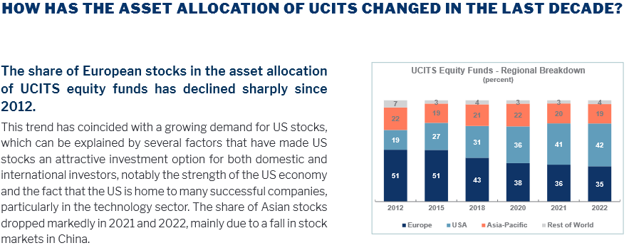
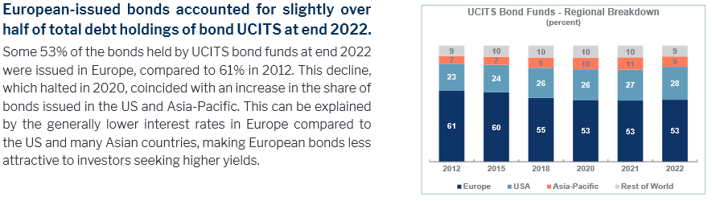
V.1. Statistics
% of US Securities in EU domiciled UCITS funds
Source EFAMA Fact Book 2023, Key findings and figures, page 8. Available here.
42% of US equities
28% of US equities
© ALFI 2023

Slide 15
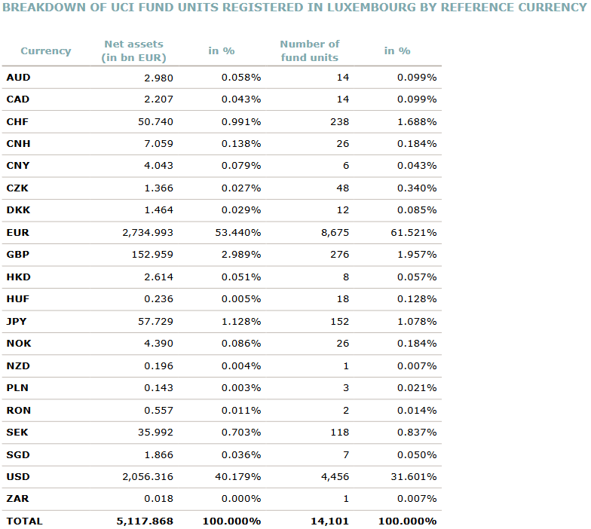
V.2. Statistics
Breakdown of Luxembourg UCI funds by reference currency
Source CSSF, Newsletter n°274 November 2023, page 13. Available here.
© ALFI 2023

Slide 16
Glossary
Acronym | Description
AP | Authorised Participant
CSDR | Central Securities Depositories Regulation
CCY | Currency
DTCC | Depository Trust and Clearing Corporation
DVP | Delivery versus Payment (Securities against Cash)
EPM | Efficient Portfolio Management
EPTF | European Post Trade Forum
ESMA | European Securities and Markets Authority
ETF | Exchange Traded Fund
EU | European Union
FOP | Free of Payment (no cash exchanged)
FX | Foreign exchange
ICI | Investment Company Institute
MBI | Mandatory Buy-In (CSDR)
NAV | Net Asset Value
RTS | Regulatory Technical Standards
SIFMA | Securities Industry and Financial Markets Association
TD | Trade Date
SD | Settlement Date
UCITS | Undertaking for Collective Investment in Transferable Securities
VD | Value Date
© ALFI 2023
INTERNAL

Slide 17
Disclaimer
The present presentation represents a consensus expressed by the members of the ALFI having authored this presentation regarding their views of currently accepted practices and approaches to the duties of a counterparty vis-à-vis its settlement obligations and procedures. This presentation is not intended to be directional in nature but informative. This presentation does not represent legal advice. Whilst reasonable endeavours are taken to ensure that the information included in this presentation is accurate and up-to-date as at the date of publication, ALFI as well as its contributing authors do not accept any liability or responsibility for any loss or damage occasioned to any person acting or refraining from acting on any information contained in this presentation. Specialist legal or other professional advice should be sought in case of any specific questions and/or queries in regard of the topics touched upon in this presentation. This presentation has not been reviewed and/or validated by any financial sector supervisory authority.
© ALFI 2023
INTERNAL

