Slide 1
Securitisation Regulation - Article 27
Register of STS notifications (STSRE)
Simplified user guide

Slide 2
Notification reporting Entity (NRE) on-boarding
STSRE ESMA IT System Features

Slide 3
NRE on-boarding / First submission
Step 1 - The Notification Reporting Entity (NRE) has to be registered at the new ESMA STS register (see slide 5)
Step 2 – Each user has to contact ESMA for creating the individual user account (see slide 6)
Step 3 – Define the delegated entities (see slide 11)
Step 4 – Prepare the non-ABCP/ABCP transaction/ABCP programme template
Step 5 – Upload the non-ABCP/ABCP transaction/ABCP programme template to create a draft STS notification (see slide 15)
Step 6 – Submit the draft non-ABCP/ABCP transaction/ABCP programme notification as final (see slide 17)

Slide 4
REGISTRATION
STSRE ESMA IT System Features

Slide 5
Registration process for new reporting entities
All STS notifications must be submitted to us via our Extranet Register portal.
Before submitting any STS notification, the Notification Reporting Entity (NRE) has to be registered at the new ESMA STS register
If your entity is not yet registered by us as an STS Notification Reporting Entity
you will need to fill in all the fields in this system registration form and email the form to IT.Helpdesk@esma.europa.eu and STSRegister_Project@esma.europa.eu.
Each of your users will have also to contact ESMA for creating the individual user account (as per instructions available at next slide)
ESMA will assign your entity a unique NRE code that will be assigned to each of the authorised entity users

Slide 6
Instructions for the creation of individual user accounts
New users will need to request access to the ESMA STS register
Each new user has to contact ESMA for creating the individual user account
New user sends a request to the ESMA STSRE point of contact (STSRegister_Project@esma.europa.eu) and ESMA helpdesk (IT.Helpdesk@esma.europa.eu) to request the creation of a new IAMAN account
New user receives an invitation email on his/her work email address
New user completes the registration steps and define his/her ESMA password
New user requests access to STSRE Extranet system by defining his/her access rights
STSRE – NRE User (administrator role with submission rights) will be authorised to submit final notification
STSRE – NRE user (standard role without submission rights) will be only authorised to upload draft notification
Once the request is approved, the new user is granted access to the STSRE Register system and can sign in using his/her ESMA identifier and password

Slide 7
Connection to the ESMA STS Register extranet
The production extranet is accessible at:
https://registers.esma.europa.eu/stsre-extranet/ (direct access after providing your credentials)
https://registers.esma.europa.eu/home-extranet/ after providing your credentials and clicking on ”Register of STS notifications”
https://registers.esma.europa.eu/publication/ after clicking on “sign in” button, providing your credentials and clicking on ”Register of STS notifications”
The test extranet is accessible at:
https://registers-t.esma.europa.eu/stsre-extranet/ (direct access after providing your credentials)
https://registers-t.esma.europa.eu/home-extranet/ after providing your credentials and clicking on ”Register of STS notifications”
https://registers-t.esma.europa.eu/publication/ after clicking on “sign in” button, providing your credentials and clicking on ”Register of STS notifications”

Slide 8
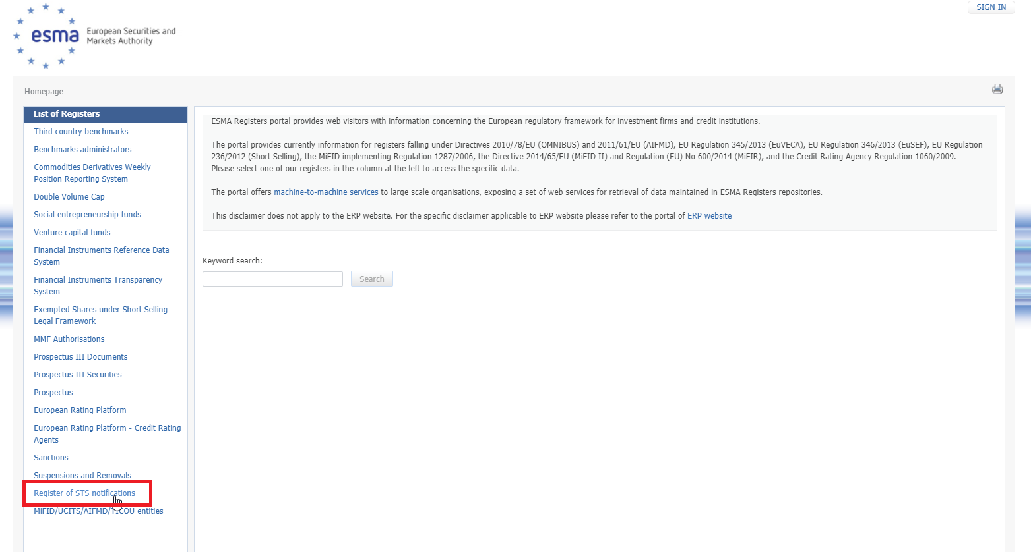
Connection to the ESMA STS Public Register
Public users can access the STSRE public website through the ESMA Registers Public website URL: https://registers.esma.europa.eu/publication/
In order to access the dedicated STSRE space you must select the ‘Register of STS notifications’ options from the list of ESMA registers.
The test public register is accessible at:
https://registers-t.esma.europa.eu/publication/ after clicking on “sign in” button, providing your credentials and clicking on ”Register of STS notifications”

Slide 9
DELEGATED ENTITIES FEATURES
STSRE ESMA IT System Features

Slide 10
Reporting Process – NRE / DE mapping
The originators and sponsors of a securitisation may outsource to a third party the submission of the STS notification to ESMA provided that originators and sponsors retain responsibility for the submitted notification. Therefore, the NREs may be:
the sponsor(s) or the originator(s) of a non-ABCP securitisation or a third party acting on behalf of the sponsor(s) and originator(s)
the sponsor(s) of an ABCP programme/transaction or a third party acting on behalf of the sponsor(s)
In order to be able to submit your reports, you must initially define the DE entities on behalf of which you are responsible to report STS notifications
One STS notification will be reported together with its unique Delegated Entity (DE) LEI (that may change during the life cycle of the STS notification).
Exceptional cases:
One DE may decide to change from one NRE to another NRE whereas STS notifications are still active and may need to be updated. → In such case, the new NRE will be able to define the old NRE that it is replacing, in order to have access to the STS notifications reported by that old NRE for that specific DE.
One DE may be related to several NREs where several STS notifications have to be reported. → But at one specific point of time, it is however not possible to have several DEs authorised for the same STS notification.

Slide 11
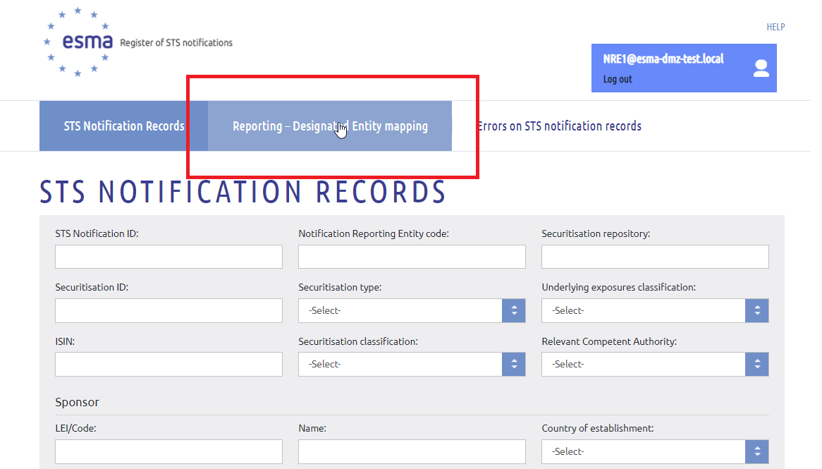
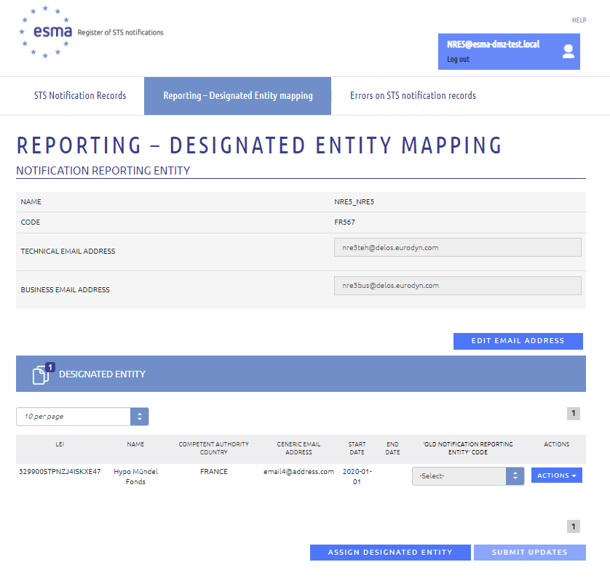
Management of NRE - DE mapping
After accessing the STSRE Register, you must click on the “Reporting – Designated Entity mapping” tab to access the “Reporting – Designated Entity mapping” page.
On this page you will be able to see the following information:
1. Notification Reporting Entity section.
2. Designated Entity section with the list of DE(s) for which your user account is defined to be responsible to submit STS notifications on their behalf
On this page you can view the following buttons:
Edit email address (generic email address that will receive notifications from register system)
You must click on the ‘Assign designated entity’ button to define additional ‘Designated Entity’ with
DE competent authority: Select the country of the DE
DE generic email address that will receive notifications from register system
DE start date/end date: Select the date from which/to which your user account may act as the NRE for the DE.
‘Old NRE’ code: Select the code of the previously authorised NRE for the DE where necessary (optional field)
Submit updates

Slide 12
SUBMISSION FEATURES
STSRE ESMA IT System Features

Slide 13
Feature for importing data through template xls file
The system provides a specific feature for data submission through an external file (XLS format). This feature allows the NRE users to:
Download the STS notification template through the Extranet:
The template is an XLS-based template different from the interim XLS template
Different template is available to be downloaded for each securitisation type
Upload the populated template:
The NREs should populate the XLS file (locally) respecting the datatype of each element:
alphanumeric/ numeric, free text elements
date elements (ISO format YYYY-MM-DD)
closed list value fields
repetitive fields (convention: value1;value2)
Elements with incorrect or inconsistent format or inconsistent contents based on validation rules are highlighted in amber
The NREs should follow the file naming convention for each file to be uploaded, i.e.:
STSNotificationRecord_NonAbcp_Template.xlsx
STSNotificationRecord_Abcp_Template.xlsx
STSNotificationRecord_AbcpProgramme_Template.xlsx
Once submitted, the file is validated against a set of validation rules.
After successful validation a draft STS notification record is created which can be further edited before it is submitted as the final version of the STS notification.
Securitisation is made available at the public list only after the successful final submission

Slide 14
Existing STS notifications to be resubmitted
Current STS notifications already submitted to ESMA cannot be automatically migrated into the new STS register as the structures of the interim and final templates are not compatible
All outstanding STS notifications available at the interim list of notified STS securitisations should be notified again at the new STS register using the new templates
The initial notification date for both private and public securitisations as well as the anonymised unique identifier for private securitisations will be kept unchanged and automatically retrieved from the initial submission based on the STS notification identifier (STSS3/STSAT3)
The STS notification identifier is equal to the 27-characters securitisation identifier
Only exception is for ABCP transactions with co-funding structures for which ESMA will provide a 29-characters identifier

Slide 15
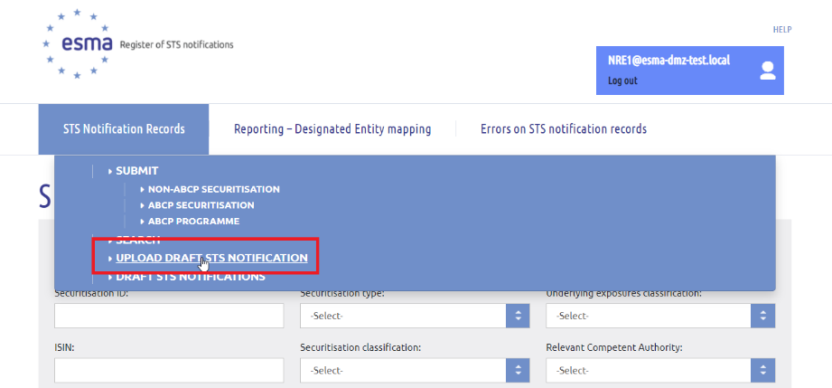
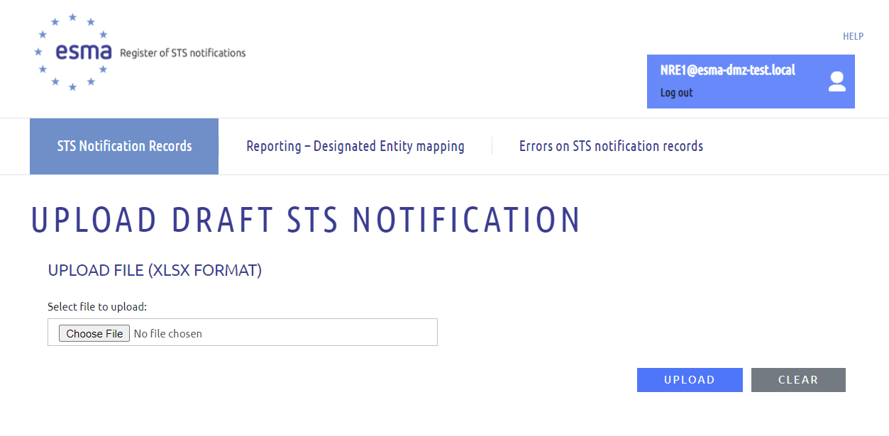
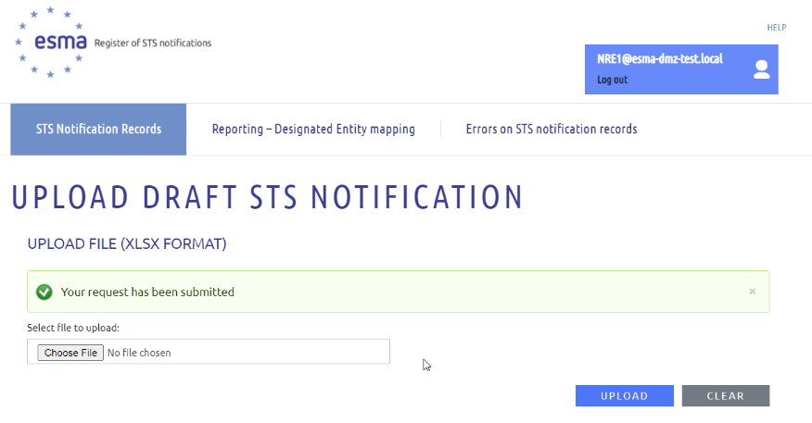
Import STS notification record
After accessing the STSRE Register, you must click on the “STS notification records” tab and the “Upload draft STS notifications” option in order to access the “Upload draft STS Notification” page.
In order to import a (new) draft STS notification record you must follow the below steps:
1. Click on the “Choose file” button.
2. Select the .xlsx file s/he wishes to upload. The file naming convention for each file should be followed:
STSNotificationRecord_NonAbcp_Template.xlsx
STSNotificationRecord_Abcp_Template.xlsx
STSNotificationRecord_AbcpProgramme_Template.xlsx
3. Click on the “Upload” button
Upon clicking on the “Upload” button, the system will present a confirmation message that the request was successfully submitted.
Error messages are displayed when:
Naming convention is not followed
Structure of the file is incorrect ( no change at the header and field names)

Slide 16
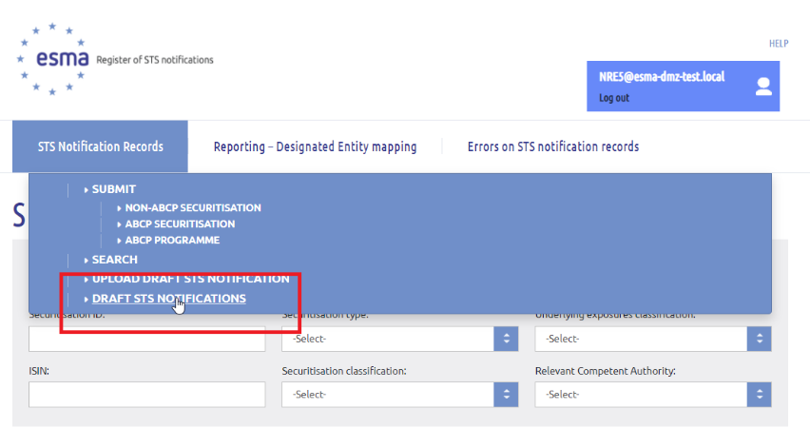
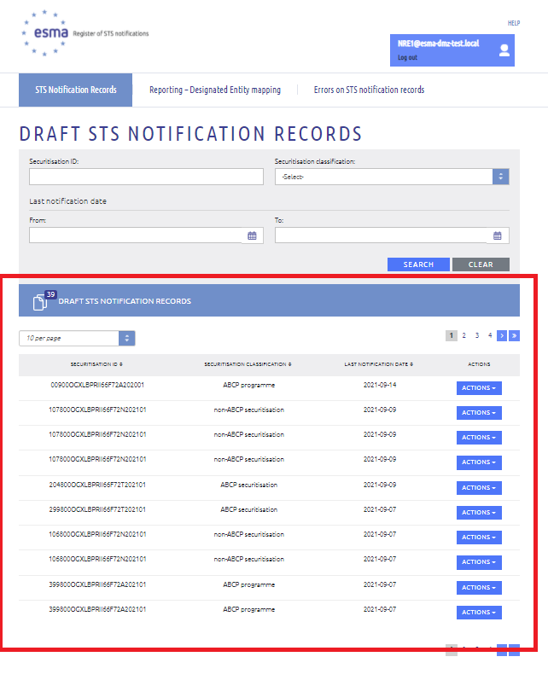
Access draft STS notification
After successful request, the imported file is accessible through the “Search draft STS notification records” page. You must click on the “STS notification records” tab and the ‘Draft STS notifications’ option in order to access the “Draft STS Notification records” page.
A filtering section is available, assisting the user in having access to specific records after clicking on the “SEARCH” button
Securitisation ID: Enter the Securitisation ID
Securitisation classification
Non-ABCP securitisation
ABCP securitisation
ABCP programme
Last notification date (From/To)
The system displays the search results that correspond to the provided search criteria and correspond to the access permissions corresponding to your user account
The search results are by default sorted on ‘Last notification date’ in descending order.

Slide 17
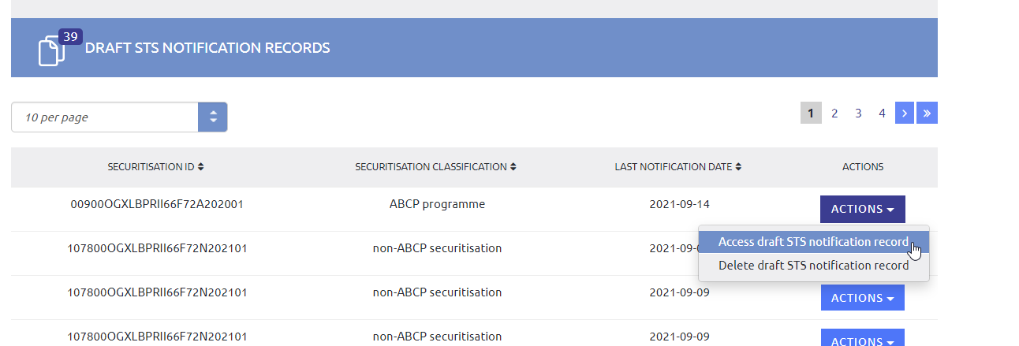
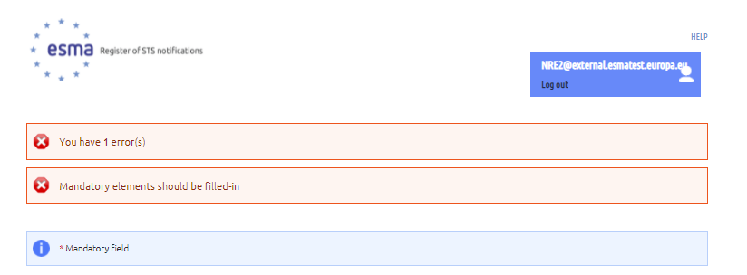
Submit draft STS notification as final
The search results table contains Actions column:
Access draft STS notification record to access the STS notification record entry form, prefilled based on the values provided.
Delete draft STS notification record (for draft notifications that may be useless).
After accessing the draft notification, you can view and edit the editable details of the selected draft STS notification record
Click on the “Submit” button
Upon clicking on the “SUBMIT” button, the system will present:
a confirmation message that the request has been successfully submitted where all real time validation rules are successfully checked
The list of errors triggered by the real time validation rules where at least one real time validation rule generates an error
The errors are self explanatory and have to be corrected before resubmission

Slide 18
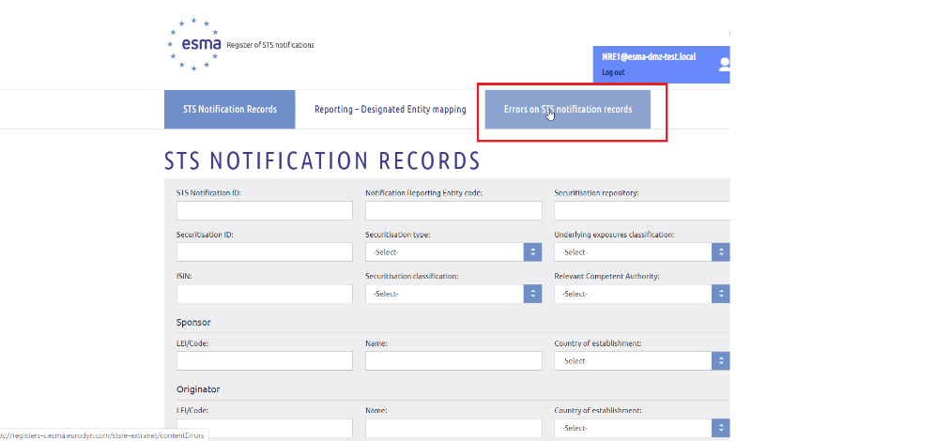
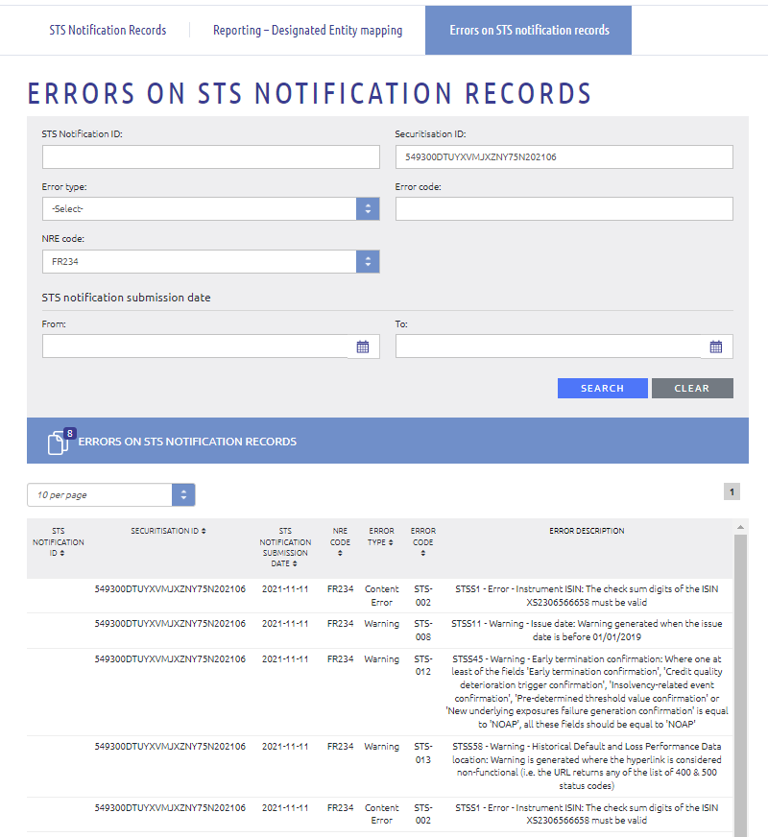
Checking STS notification submitted as final
When the “SUBMIT” request has been successfully submitted, you have to check whether the notification was accepted by the system against the set of validation rules
You must click on the “Errors on STS Notification records” tab to access the “Errors on STS Notification records” page and search information on:
failed submissions
accepted submissions with warnings
A filtering section is available, assisting the users in having access to specific errors on STS notification records
After having clicked on the “SEARCH” button, the system displays the search results
You will have to check:
the content errors to fix the issues that prevent the successful submission
the warnings and fix any issue that would be necessary to correct
A notification email summarising the content errors and warnings is also sent to the business email address configured for the reporting entity

Slide 19
Access the final STS notifications (Extranet pages)
Once successfully submitted and processed by the system, the new STS notifications is made available at the list of submitted STS notifications
1. Search page
The Search functionality allows the Extranet users to retrieve new (and historical) data on the submitted STS notifications.
The search results are displayed in table format and can be downloaded (CSV, PDF format).
2. Details page
Through the search results the Extranet user can access the details page of a selected notification displayed in the search results table.
The details page:
presents the contents of the selected STS notification
supports the exporting of the STS notification contents (CSV, PDF format)

Slide 20
Access the final STS notifications (Public pages)
The day after the successful final submission of the notification, the new STS securitisation is made available at the public list of submitted STS notifications available at https://registers-t.esma.europa.eu/publication/searchRegister?core=esma_registers_stsre
1. Search page
The Search functionality allows the public users to retrieve the last version on the submitted STS notifications.
The search results are displayed in table format and can be downloaded (CSV, PDF format).
2. Details page
Through the search results the public user can access the details page of a selected notification displayed in the search results table.
The details page:
presents the contents of the selected STS notification depending on the nature of selected records, i.e.
STS compliant notification on public securitisation
STS compliant notification on private securitisation
Non-STS compliant notification on public securitisation
Non-STS compliant notifications on private securitisation
supports the exporting of the STS notification contents (CSV, PDF format)

Slide 21
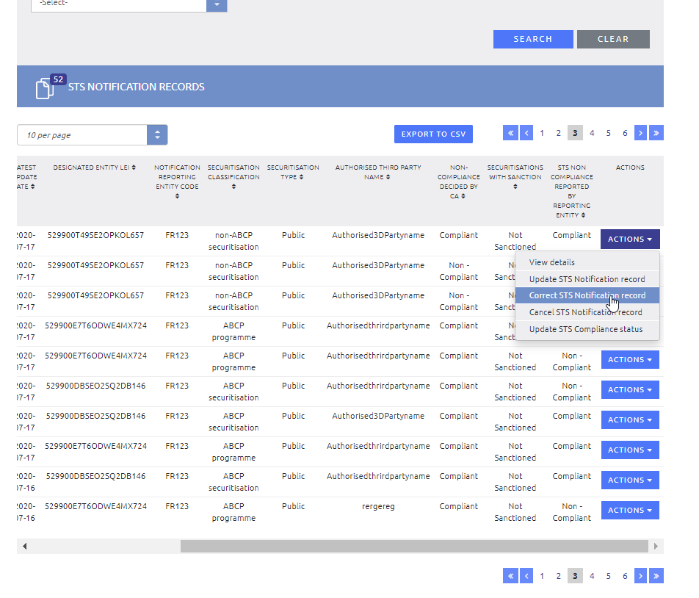
Update/Correct STS notification submitted as final
After having performed a search on the STS Notification records (at the STS Notification Record/Sub menu search)
You must click on the “ACTIONS” drop-down button of the desired STS notification record, available for each record under the “ACTIONS” column.
Select the “Correct STS notification record” or the “Update STS notification record” option, available for the latest valid (and not cancelled) NRE STS compliant version of each STS notification record
Upon clicking on the option you will be redirected to the “NON – ABCP” / “ABCP”/ “ABCP PROGRAMME” page.
Correct/Update the desired fields using the drop-down menus, text-boxes and date pickers.
Update description has to be populated before submitting the new version of the securitisation.
Correct action is for correcting an erroneous information whereas
Update action is for updating an information that has changed

Slide 22
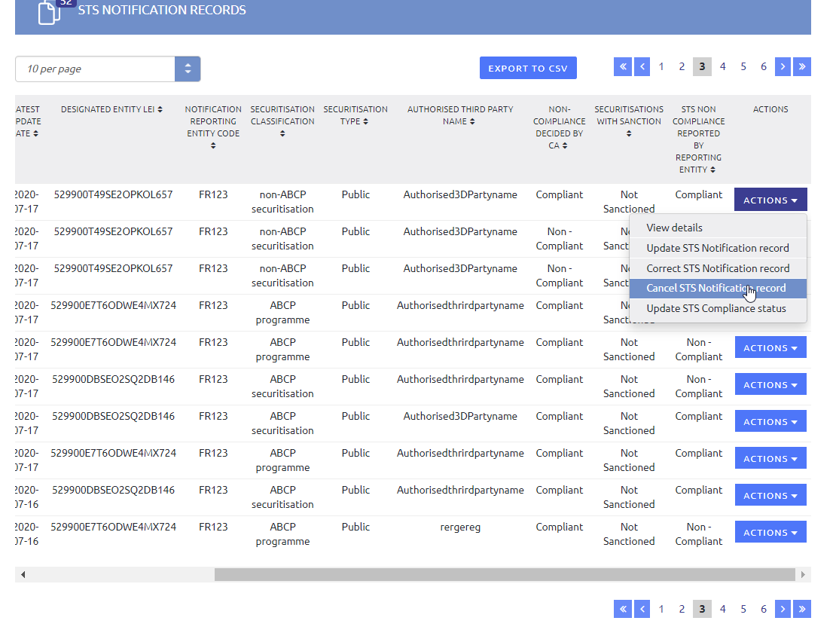
Cancel STS notification submitted as final
After having performed a search on the STS Notification records (at the STS Notification Record/Sub menu search)
Click on the “ACTIONS” drop-down button of the desired STS notification record, available for each record under the “ACTIONS” column.
Select the “Cancel STS notification record” option, available for the latest valid (and not cancelled) version of each STS notification record
Cancel action has to be done for example when erroneous securitisation unique identifier has been reported

Slide 23
VALIDATION RULES
STSRE ESMA IT System

Slide 24
Data validation
The STSRE system processes the data against the following types of validation rules:
Real time validation, guiding the submitting entity to:
Complete all mandatory elements of the submission form
Fill-in correct data in relation to:
the datatype of the corresponding data submission element
the technical guidance of the corresponding data submission element
Populate the STS compliance elements of the submission form properly (to ensure that all compliance elements are confirmed at the submission form).
Post-submission validation, validating the submitted data against a set of validation rules. Failing of such content validation rules leads to the generation of either (a) warnings, or (b) content errors.
Warnings
If one or more warnings are identified (but no errors), then the submitted STS notification record is accepted by the system.
Warnings are generated where an inconsistent content is detected but do not prevent the publication of the STS notification
NRE remains responsible for performing any necessary corrective actions
Content errors
If at least one error is identified, then the submitted STS notification record is rejected by the system (errors are mainly related to incorrect LEI or ISINs).
Content errors are generated where blocking technical issues prevent the processing of the STS notification

Slide 25
Data validation – feedback to reporting entity
Following content validation, the system generates an email to inform the NRE about the data validation outcome.
The content of the feedback notification email comprises validation information regarding the STS Notification record, containing:
The Status of the submitted report (i.e. whether the report was accepted, or accepted with warnings, or rejected with content errors)
If applicable, the Validation Rule that failed (i.e. identification and description of the content validation rule)
Attachment of the PDF export of the submitted STS notification, only in the case where the STS notification report is accepted (i.e. no content errors identified)
The list of failed validation rules is also available at the specific Extranet error page

Slide 26
Special cases – email notifications
For the following cases the STSRE system generates email notifications to inform the email recipients and prevent any misreporting:
When the CA STS non-compliance status has been updated (by the RCA(s) or an ESMA user on behalf of RCAs)
→ This email notification is dispatched to (a) the reporting NRE, (b) the reported DE, (c) the RCA(s) of the submitted STSRE notification and (d) ESMA Securitisation Regulation team
When an old NRE-DE mapping is defined by an NRE (so that this account is from now on authorised to update/ correct/ cancel past STS notification submissions for this DE)
→This email is dispatched to (a) the newly authorised NRE, (b) the reported DE, (c) the old authorised NRE (NRE designated by the new NRE as the old NRE), (d) the responsible CA of the reported DE, and (a) the ESMA Securitisation Regulation team
When a DE is linked with more than one NREs
This email notification is dispatched to (a) the reporting NRE, (b) the reported DE, and (c) the responsible CA of the reported DE
When an updated/ corrected version of a notification is received containing a different DE LEI:
→ This email notification is dispatched to (a) the reporting NRE, (b) the responsible CA of the old DE, (c) the responsible CA of the new DE, and (d) the ESMA Securitisation Regulation team.

Slide 27
Imported XLS validation
The system validates the imported data according to the rules defined in the table. Once populated at the data entry form the imported data undergo the real time validation process (as if the data were filled-in at the data entry form manually).
Type of element | System validation
Alphanumeric elements (e.g. LEI, ISIN, Securitisation ID, etc.) | If the value provided has less characters than those defined for the respective reporting field, then the value is populated in the entry form and remains editable.
 | If the value provided has more characters than those defined for the respective reporting field, then the system does not populate the respective value in the entry form. Hence, the respective entry form field is presented as empty.
Numeric elements | If the value provided is a non-numerical value then the system does not populate the respective value in the entry form. Hence, the respective entry form field is presented as empty.
Date elements | If the provided value does not follow the ISO format i.e. YYYY-MM-DD, the system does not populate the respective value in the entry form. Hence, the respective entry form field is presented as empty.
Yes/No elements | If the provided value is not equal to 'Y', for any other value provided (null or string) the system will store the 'N' value.
Closed list elements (e.g. CA code, Country code, Securitisation name, etc.) | If the provided value is not available in the closed list of the respective field, the system does not populate the provided value in the entry form. The drop down list available in the entry form will be by default set to 'Select‘.
Repetitive elements | If the values provided in the repetitive fields do not follow the following naming convention: value1;value2 the system will not be able to distinguish that multiple values have been provided.

Slide 28
Data validation – Post-submission validation
Content error validation rules of Non-ABCP securitisation notification data
Field code | Field name | Error/ Warning | Error description | Error Code
N2 | STSS0 - Designated Entity LEI | E | STSS0 - Designated Entity LEI: The NRE code of the submitting entity is authorised for the reported DE LEI and the last notification date is within the start date and end date defined for that DE LEI (at the NRE reference table) | STS - 001
N3 | STSS1 - Instrument ISIN | E | STSS1 - Instrument ISIN: The check sum digits of the ISIN [ISIN] must be valid | STS - 002
N3 | STSS1 - Instrument ISIN | E | STSS1 - Instrument ISIN: The same ISIN [ISIN] cannot be filled-in twice | STS - 003
N6 | STSS2 - Originator LEI | E | STSS2 - Originator LEI: The LEI [LEI] must be an existing LEI according to the GLEIF database at the submission date | STS - 004
N8 | STSS2 - Sponsor LEI | E | STSS2 - Sponsor LEI: The LEI [LEI] must be an existing LEI according to the GLEIF database at the submission date | STS - 004
N10 | STSS2 - Original Lender LEI | E | STSS2 - Original Lender LEI: The LEI [LEI] must be an existing LEI according to the GLEIF database at the submission date | STS - 004
N24 | STSS9 - Securitisation classification | E | STSS9 - Securitisation classification: Only 1 STS notification may exist on the same Securitisation identifier for non-ABCP securitisations | STS - 009
N81 | STSS34 - Retaining entity LEI | E | STSS34 - Retaining entity LEI: The LEI [LEI] must be an existing LEI according to the GLEIF database at the submission date | STS - 004

Slide 29
Data validation – Post-submission validation
Content warning validation rules of Non-ABCP securitisation notification data
Field code | Field name | Error/ Warning | Error description | Error Code
N10 | STSS2 - Original Lender LEI | W | STSS2 - Original Lender LEI: Where populated, the LEI [LEI] must have status different from “DUPLICATE” OR “ANNULLED” according to the GLEIF database at the submission date. | STS - 005
N10 | STSS2 - Original Lender LEI | W | STSS2 - Original Lender LEI: Where populated, the LEI [LEI] must have 'NULL' validity end date | STS - 006
N19 | STSS5 - Prospectus identifier | W | STSS5 - Prospectus identifier: Prospectus identifier mandatory when Securitisation type is Public and securitisations that are not exempt from the obligation to publish a prospectus. | STS - 007
N21 | STSS11 - Issue date | W | STSS11 - Issue date: Warning generated when the issue date is before 01/01/2019 | STS - 008
N45 | STSS23 - True sale or assignment transfer confirmation | W | STSS23 - True sale or assignment transfer confirmation: Warning generated when at least one of the confirmation element is equal to ‘Unconfirmed' | STS - 010
N75 | N75 - Payment exemption | W | STSS32: Payment exemption: Warning generated when field 'At least one payment at the time of transfer confirmation' is equal to ‘Unconfirmed' and field 'Payment exemption' is equal to 'No exemption' | STS - 011
N81 | STSS34 - Retaining entity LEI | W | STSS34 - Retaining entity LEI: Where populated, the LEI [LEI] must have status different from “DUPLICATE” OR “ANNULLED” according to the GLEIF database at the submission date. | STS - 005
N81 | STSS34 - Retaining entity LEI | W | STSS34 - Retaining entity LEI: Where populated, the LEI [LEI] must have 'NULL' validity end date | STS - 006

Slide 30
Data validation – Post-submission validation
Content warning validation rules of Non-ABCP securitisation notification data
Field code | Field name | Error/ Warning | Error description | Error Code
N2 | STSS0 - Designated Entity LEI | W | STSS0 - Designated Entity LEI: The value of the Designated Entity LEI should be equal either to Originator LEI or Sponsor LEI | STS - 024
N6 | STSS2 - Originator LEI | W | STSS2 - Originator LEI: Where populated, the LEI [LEI] must have status different from “DUPLICATE” OR “ANNULLED” according to the GLEIF database at the submission date. | STS - 005
N6 | STSS2 - Originator LEI | W | STSS2 - Originator LEI: Where populated, the LEI [LEI] must have 'NULL' validity end date | STS - 006
N8 | STSS2 - Sponsor LEI | W | STSS2 - Sponsor LEI: Where populated, the LEI [LEI] must have status different from “DUPLICATE” OR “ANNULLED” according to the GLEIF database at the submission date. | STS - 005
N8 | STSS2 - Sponsor LEI | W | STSS2 - Sponsor LEI: Where populated, the LEI [LEI] must have 'NULL' validity end date | STS - 006
N95 | STSS37 - Common standards underwriting derivatives | W | STSS37 - Common standards underwriting derivatives: “N/A" should be reported in STSS37 confirmation when STSS36 confirmation elements is "No derivatives" | STS - 022
N95 | STSS37 - Common standards underwriting derivatives | W | STSS37 - Common standards underwriting derivatives: "N/A" should not be reported in STSS37 confirmation element when STSS36 confirmation element is not equal to "No derivatives" | STS - 023
N111 | STSS44 - Credit quality deterioration trigger | W | STSS44 - Credit quality deterioration trigger confirmation: Field should not be equal to "N/A" when "Confirmed" is reported for STSS44 - Non-sequential priority of payments triggers confirmation | STS - 029
N115 | STSS45 - Early termination confirmation | W | STSS45 - Early termination confirmation: Where one at least of the fields 'Early termination confirmation', 'Credit quality deterioration trigger confirmation', 'Insolvency-related event confirmation', 'Pre-determined threshold value confirmation' or 'New underlying exposures failure generation confirmation' is equal to 'NOAP', all these fields should be equal to 'NOAP' | STS - 012
N143 | STSS58 - Historical Default and Loss Performance Data location | W | STSS58 - Historical Default and Loss Performance Data location: Warning is generated where the hyperlink is considered non-functional (i.e. the URL returns any of the list of 400 & 500 status codes) | STS - 013
N150 | STSS61 - Environmental performance availability | W | STSS61 - Environmental performance availability: Confirmation code NOAP and the underlying exposure type is residential loans or auto loans or leases | STS - 014

Slide 31
Data validation – Post-submission validation
Content error validation rules of ABCP securitisation notification data
Field code | Field name | Error/ Warning | Error description | Error Code
T2 | STSAT0 - Designated Entity LEI | E | STSAT0 - Designated Entity LEI: The NRE code of the submitting entity is authorised for the reported DE LEI and the last notification date is within the start date and end date defined for that DE LEI (at the NRE reference table) | STS - 001
T3 | STSAT1 - Instrument ISIN | E | STSAT1 - Instrument ISIN: The check sum digits of the ISIN [ISIN] must be valid | STS - 002
T3 | STSAT1 - Instrument ISIN | E | STSAT1 - Instrument ISIN: The same ISIN [ISIN] cannot be filled-in twice | STS - 003
T6 | STSAT2 - Originator LEI | E | STSAT2 - Originator LEI: The LEI [LEI] must be an existing LEI according to the GLEIF database at the submission date | STS - 004
T8 | STSAT2 - Sponsor LEI | E | STSAT2 - Sponsor LEI: The LEI [LEI] must be an existing LEI according to the GLEIF database at the submission date | STS - 004
T22 | STSAT9 - Securitisation classification | E | STSAT9 - Securitisation classification: Only 1 STS notification may exist on the combination of the same securitisation identifier, Designated Entity and sponsor for ABCP securitisation | STS - 016

Slide 32
Data validation – Post-submission validation
Content warning validation rules of ABCP securitisation notification data
Field code | Field name | Error/ Warning | Error description | Error Code
T2 | STSAT0 - Designated Entity LEI | W | STSAT0 - Designated Entity LEI: The value of the Designated Entity LEI should be equal either to Originator LEI or Sponsor LEI | STS - 024
T6 | STSAT2 - Originator LEI | W | STSAT2 - Originator LEI: Where populated, the LEI [LEI] must have status different from “DUPLICATE” OR “ANNULLED” according to the GLEIF database at the submission date. | STS - 005
T6 | STSAT2 - Originator LEI | W | STSAT2 - Originator LEI: Where populated, the LEI [LEI] must have 'NULL' validity end date | STS - 006
T8 | STSAT2 - Sponsor LEI | W | STSAT2 - Sponsor LEI: Where populated, the LEI [LEI] must have status different from “DUPLICATE” OR “ANNULLED” according to the GLEIF database at the submission date. | STS - 005
T8 | STSAT2 - Sponsor LEI | W | STSAT2 - Sponsor LEI: Where populated, the LEI [LEI] must have 'NULL' validity end date | STS - 006
T19 | STSAT11 - Issue date | W | STSAT11 - Issue date: Warning generated when the issue date is before 01/01/2019 | STS - 008
T22 | STSAT9 - Securitisation classification | W | STSAT9 - Securitisation classification: Only 1 STS notification may exist on the combination of the same securitisation identifier and Designated Entity for ABCP securitisation | STS - 015
T43 | STSAT23 - Transfer where the seller is not the original lender confirmation | W | STSAT23 - True sale or assignment transfer confirmation: Warning generated when at least one of the confirmation element is equal to ‘Unconfirmed' | STS - 010
T57 | STSAT39 - Derogation on pools of auto loans, auto leases or equipment lease confirmation | W | STSAT39 - Derogation on pools of auto loans, auto leases or equipment lease: "Applicable" should be reported when STSAT39 - Remaining WAL confirmation is equal to "Confirmed" | STS - 032
T77 | STSAT29 - Payment exemption | W | STSAT29 - Payment exemption: Warning generated when field 'At least one payment at the time of transfer confirmation' is equal to ‘Unconfirmed' and field 'Payment exemption' is equal to 'NONE' | STS - 017

Slide 33
Data validation – Post-submission validation
Content warning validation rules of ABCP securitisation notification data
Field code | Field name | Error/ Warning | Error description | Error Code
T87 | STSAT34 - Common standards underwriting derivatives confirmation | W | STSAT34 - Common standards underwriting derivatives: “N/A" should be reported in STSAT34 confirmation when STSAT32 confirmation element is "No derivatives" | STS - 022
T87 | STSAT34 - Common standards underwriting derivatives confirmation | W | STSAT34- Common standards underwriting derivatives: "N/A" should not be reported in STSAT34 confirmation element when STSAT32 confirmation element is not equal to "No derivatives" | STS - 023
T99 | STSAT48 - Early termination confirmation | W | STSAT48 - Early termination confirmation: One of the "Early termination confirmation" / "Credit quality deterioration trigger confirmation" / "Insolvency-related event confirmation" elements is not set to "N/A" while the remaining are set to "N/A" | STS - 018
T101 | STSAT48 - Credit quality deterioration trigger confirmation | W | STSAT48 - Credit quality deterioration trigger confirmation: One of the "Early termination confirmation" / "Credit quality deterioration trigger confirmation" / "Insolvency-related event confirmation" elements is not set to "N/A" while the remaining are set to "N/A" | STS - 018
T103 | STSAT48 - Insolvency-related event confirmation | W | STSAT48 - Insolvency-related event confirmation: One of the "Early termination confirmation" / "Credit quality deterioration trigger confirmation" / "Insolvency-related event confirmation" elements is not set to "N/A" while the remaining are set to "N/A" | STS - 018
T6 | STSAT2 - Originator LEI | W | STSAT2 - Originator LEI: The Originator LEI should be provided. | STS - 030

