Slide 1
ESMA’s consultation papers on securitisation repositories
Adrien Amzallag

Slide 2
Outline – Securitisation Repositories
Legal basis and timing considerations
Technical standards on application requirements
Guidelines on securitisation data portability
Technical advice on supervisory fees

Slide 3
Legal basis and timing considerations
13 April 2018 | Paris
Securitisation repositories:
  Receive and publish disclosures (Article 7 & 17 of the Securitisation Regulation)
  Verify completeness and consistency of information received (Article 10)
  Are registered and supervised by ESMA (Article 10)
ESMA to draft RTS and ITS on application requirements (Article 10(2))
Issue of data portability across repositories
  ESMA can issue guidelines “to facilitate common, uniform, and consistent application of Union law” (Article 16(1) of the ESMA Regulation)
Supervisory fees (Article 16):
  Repositories must pay for ESMA’s necessary expenditures re: registration and supervision
  31 Jan. 2018: Commission requests technical advice from ESMA
Timing considerations:
  23 May 2018: Deadline to respond to these consultation papers
  Q3 2018: ESMA aims to submit final report on standards & advice and to finalise guidelines
  Actual registration of repositories must wait until delegated acts are adopted by Commission

Slide 4
Technical standards on application requirements
Aim: consistency w/ existing RTSs (EMIR, SFTR, CRA3) but reflect securitisation specificities
Implementation of EMIR Article 78 (“General Requirements”), including:
  organisational/ownership details and structure,
  corporate governance; policies and procedures,
  internal control and compliance; conflicts of interest,
  staffing policies and IT resources,
  ancillary services,
  access conditions,
  pricing policy transparency
Implementation of EMIR Article 79 (“Operational Reliability”), including:
  operational risk mitigation,
  security,
  outsourcing,
  completeness and consistency checks
Implementation of EMIR Article 80 (“Safeguarding and Reporting”), including:
  confidentiality of information and recordkeeping policy
Some items not required for trade repositories (if unchanged since application), including:
  corporate governance, ownership, staffing policies

Slide 5
Guidelines on securitisation data portability
Experience with trade repositories (guidelines on TR data portability)
Driven also by the Securitisation Regulation (recital 13)
  It is important to create a comprehensive system under which investors and potential investors will have access to all the relevant information over the entire life of the transactions
Seek to remove potential coordination barriers, under two scenarios:
A customer wishes to switch reporting to another repository:
  Switch should be relatively quick (agree migration within 5 days)
  Cover information received by the repository, unique identifiers, and reporting logs
  Old repository to still store data for 10 years after maturity (safeguard)
A repository’s registration is withdrawn:
  Similar to scenario 1, but e.g.:
  ESMA receives migration plan as part of wind-down arrangements
  Users must be notified in advance (6 months or, for a ‘large’ repository, 9 months)
  Data in ‘old repository’ to be securely destroyed
  Fees should not be charged by the ‘old repository’ or ‘new repository’ for this transfer

Slide 6
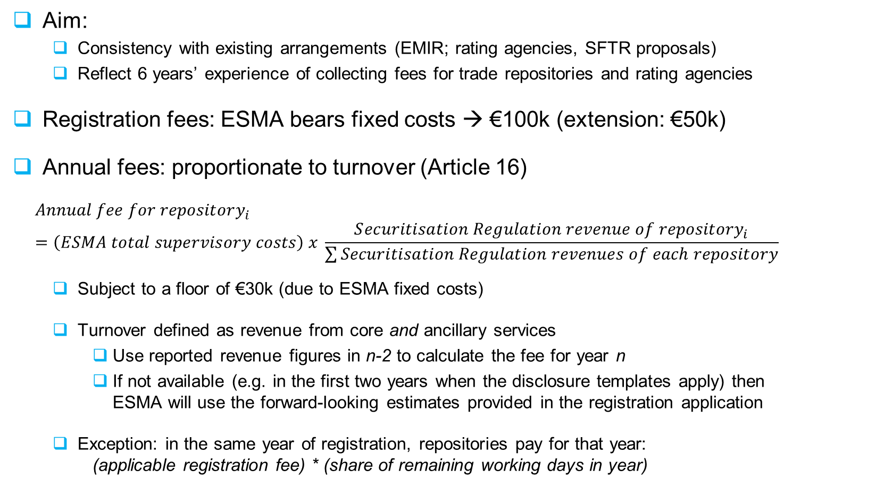
Technical Advice on supervisory fees
Aim:
  Consistency with existing arrangements (EMIR; rating agencies, SFTR proposals)
  Reflect 6 years’ experience of collecting fees for trade repositories and rating agencies
Registration fees: ESMA bears fixed costs → €100k (extension: €50k)
Annual fees: proportionate to turnover (Article 16)
$$Annual fee for repository_{i}=\left(ESMA total supervisory costs\right) x \frac{S{ecuritisation Regulation revenue of repository}_{i}}{\sum{Securitisation Regulation revenues of each repository}}$$
  Subject to a floor of €30k (due to ESMA fixed costs)
  Turnover defined as revenue from core and ancillary services
    Use reported revenue figures in n-2 to calculate the fee for year n
    If not available (e.g. in the first two years when the disclosure templates apply) then ESMA will use the forward-looking estimates provided in the registration application
  Exception: in the same year of registration, repositories pay for that year: (applicable registration fee) * (share of remaining working days in year)

Slide 7
13 April 2018 | Paris
Thank you

