Slide 1
2021 Cost and Past Performance Report
Main findings
Webinar 21 April 2020

Slide 2

Content
1. Overview of the main findings on IBIPs and PPPs
2. Issues identified
3. Upcoming

Slide 3
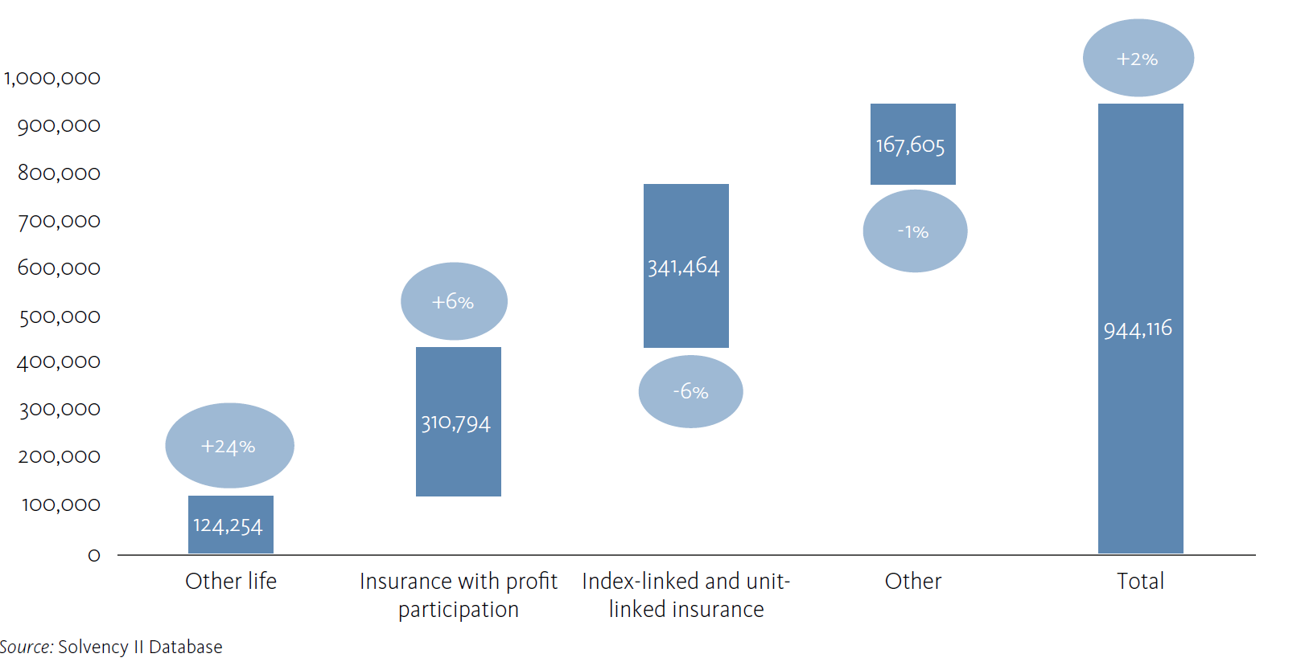
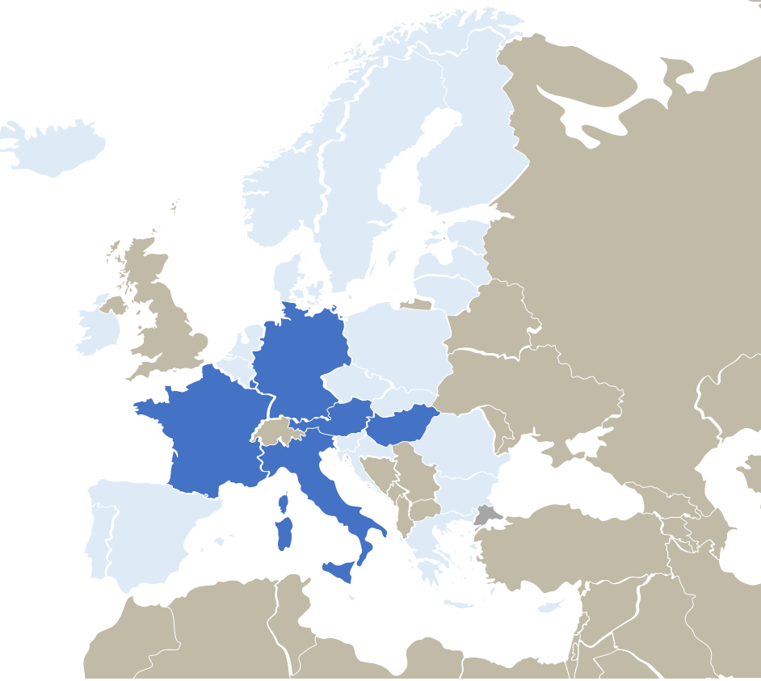

The European Insurance Based Investment Products (IBIPs) market
GWP - € million (LHS) and YoY growth rate (RHS)
The findings are based on a sample covering more than 680 Insurances based investment products (IBIPs) being marketed by over 160 insurance undertakings covering the 60% of the European IBIPs market
Hybrid products
With the increasing shift from traditional profit participation products to products with less guarantees, hybrid products are becoming more and more common. Being relevant in FR, IT, LU, HU, AT, DE

Slide 4
IBIPs – main findings
2019 was an extremely positive year for the IBIPs market at European level and positive net return across all Members States, in line with general market trends.
The net performance of profit participation products, despite being steadily positive in all years of the analysis, is low, in particular when considering the impact inflation can have in some markets.
Profit participation products continue to be less costly than unit-linked and hybrid products.
The performance of unit-linked products varies according to the level of risk being taken, while for profit participation products, the recommended holding period is the main factor.
On hybrid products while these seek to combine the benefits of profit-participation and unit-linked products, they are generally more costly and complex, raising some potential challenges in assessing them.

Slide 5

Net Returns and Costs of IBIPs in Europe
UL volatility is high: 2019 net return was extremely positive
PP products continue to offer stable, despite generally low, returns especially when considering the impact of inflation
UL
  UL Net Return
  11.4%, median EEA 2019
  2.7%, median EEA 2019-2015
  PP Net Return
  1.2%, median EEA 2019
  1.4%, median EEA 2019-2015
  Hybrid Net Return
  5.0%, median EEA 2019
  2.1%, median EEA 2019-2015
Cost – 2019
(as RIY at RHP)
UL: 2.5%
PP: 1.5%
Hybrid: 2.1%
PP

Slide 6
Net return by Member State - IBIPs
UL
2019 was an extremely positive year for the IBIPs market at European level
When considering the inflation effect, the value offered to consumers has been on average very little in real terms, particularly PP products.
Trends amongst different Member States are homogeneous, with UL net return always higer than PP and Hybrid.
PP
Hy

Slide 7
Cost by Member State - IBIPs
UL
2.5%
On average, PP are less costly than UL products.
From a ‘value for money’ perspective, some trade-offs need to be considered in terms of returns and costs for hybrid products. Their costs are higher than PP while still offering lower return than UL.
PP
1.5%
Hy
2.1%

Slide 8
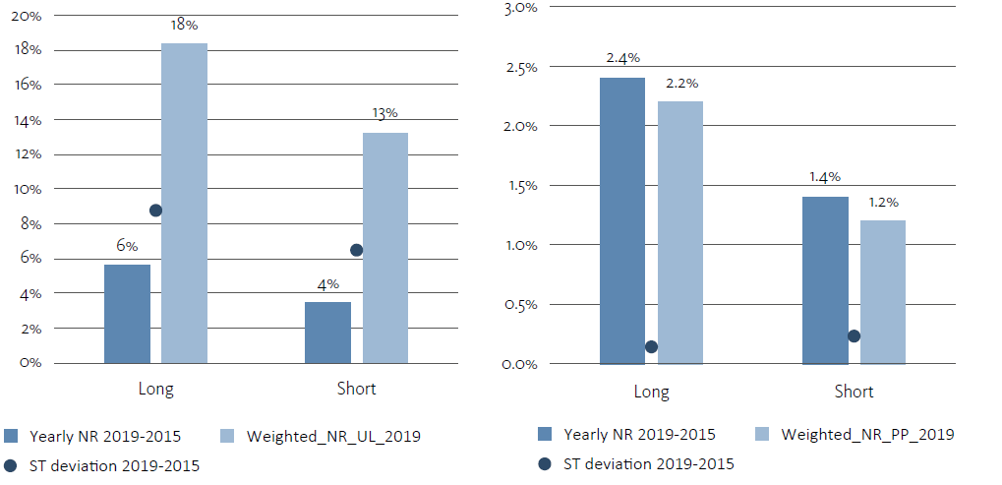
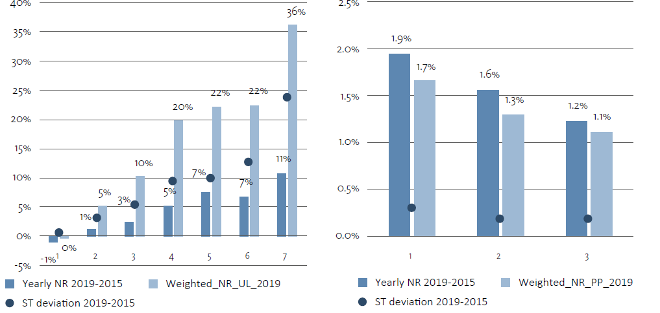
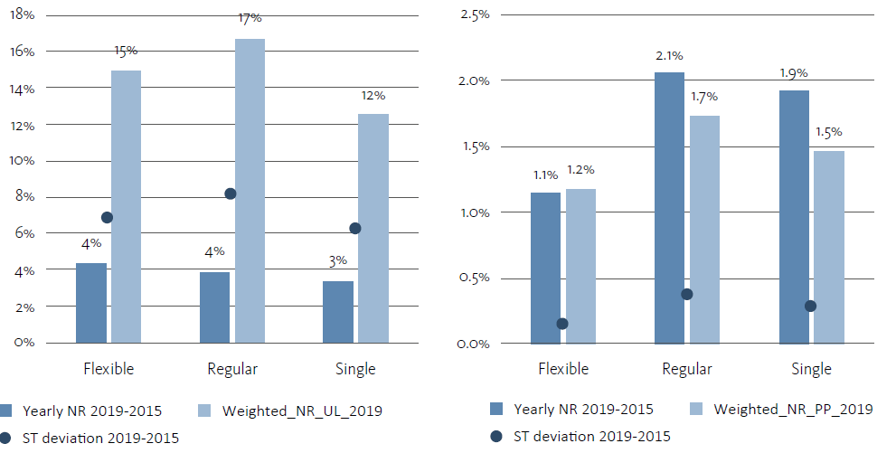
Net return - IBIPs
2. Recommended Holding Period
1. Risk Class
UL
PP
UL
PP
3. Premium Frequency
PP
UL
Higher net return correlates with higher risk classes for UL products, while for PP the correlation is inverse and less marked
Products with a longer RHP proved to pay a higher net return for both UL and PP products but more remarked for PP
No clear correlation between the net return and premium frequency could be observed.

Slide 9
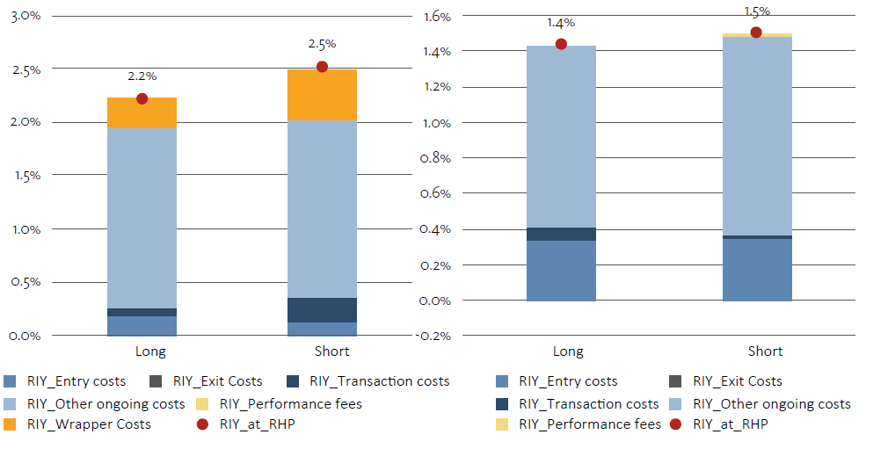
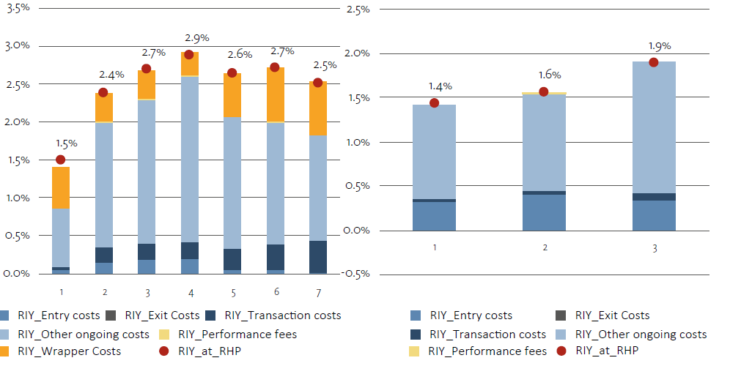
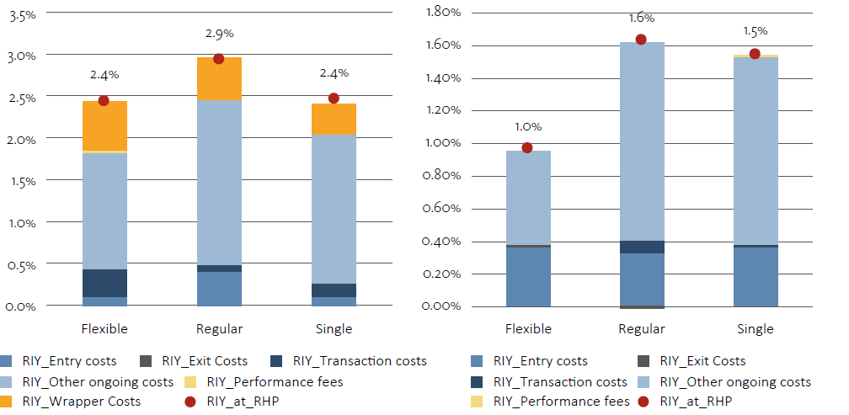
Costs - IBIPs
2. Recommended Holding Period
UL
PP
1. Risk Class
UL
PP
3. Premium Frequency
UL
PP
Costs are much more homogeneous than net returns when considering different risk classes, RHP, and premium frequency.
Short-term products are more costly than the longer term ones.
Costs for regular premium products are higher in both UL and PP products.

Slide 10
Personal Pension Products - PPPs
Trends in the net return and costs of are similar to those observed for IBIPs: higher average annual return but also higher volatility for personal pension products similar to unit-linked (PPP-UL) in comparison with personal pension products similar to profit participation products (PPP-PP). Costs were lower for PPP-UL than for IBIPs.
A longer recommended holding period is also identified as a driver of extra performance, in particular in relation to product similar to profit participation. Being pension products, by their nature, characterized by longer time duration the relation is more marked than in IBIPs.
Amongst different Members States trends in net return were homogenous, with PPP-UL net return in 2019 being extremely positive.
Challenges due to the lack of harmonization are still relevant

Slide 11
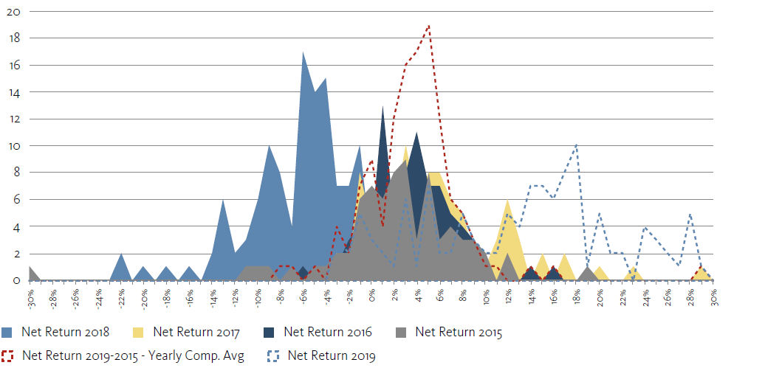

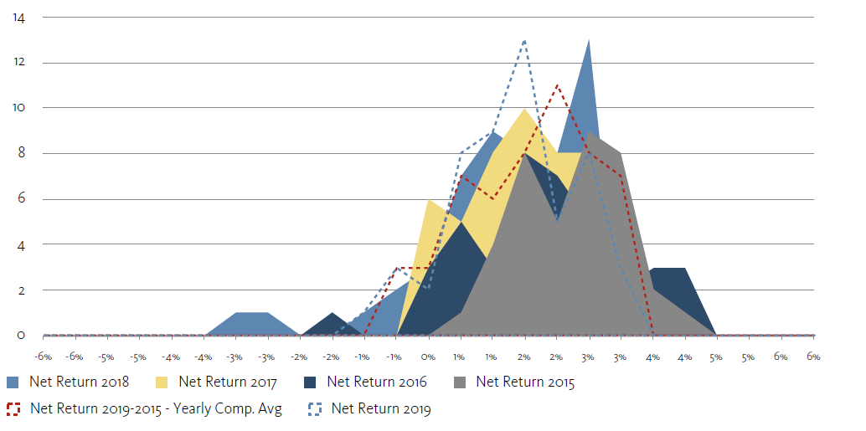
Net Returns and Costs of PPPs - EEA
Similar to IBIPs, the net returns of PPPs similar to UL has higher volatility than those similar to PP
The performance of PPPs is better than IBIPs both in terms of costs and net return
Despite the diversity in the national framework on PPPs, trends amongst different markets are homogeneous
UL
  PPP-UL Net Return
  14.1%, median EEA 2019
  3.5%, median EEA 2019-2015
  PPP-PP Net Return
  1.2%, median EEA 2019
  1.4%, median EEA 2019-2015
Cost – 2019
(as RIY at RHP)
UL: 1.9%
PP: 1.6%
PP

Slide 12
1. Overview of the main findings on IBIPs and PPPs
2. Issues identified
3. Upcoming

Slide 13


2. Issues identified
Value for money: instances of high costs or low-negative net return have been reported, raising questions on value for money in particular taking into account the inflation effect.
€
Complex costs structure: for some products it is difficult to get the total cost information because of the different layers – wrapper and underline – and the different points time in which costs are charged
Lack of harmonization: persistent challenges especially related to PPPs, where no European framework is available

Slide 14
1. of the main findings on IBIPs and PPPs
2. Issues identified
3. Upcoming

Slide 15
3. Upcoming
Pension Products
IORPs: Extended analysis, including more detailed analysis on cost levels by AC, Member States and on DC schemes at aggregate level.
PPPs: Further work on standardization and harmonization of the data collected
IBIPs - ESG Products
Next steps
EIOPA plan to introduce some analysis comparing costs and past performance of ESG and non ESG products
Costs Transparency
Costs are often high and opaque, it is difficult to understand if they are “due” and in line with peers’ products hence EIOPA would keep up working on the data collection

Slide 16
For more information visit:
https://www.eiopa.europa.eu

